Slide 1

AuE-8230 Autonomy: Science and Systems
Capstone Project
Group 1: Chinmay Samak, Tanmay Samak
Codebase

Slide 2
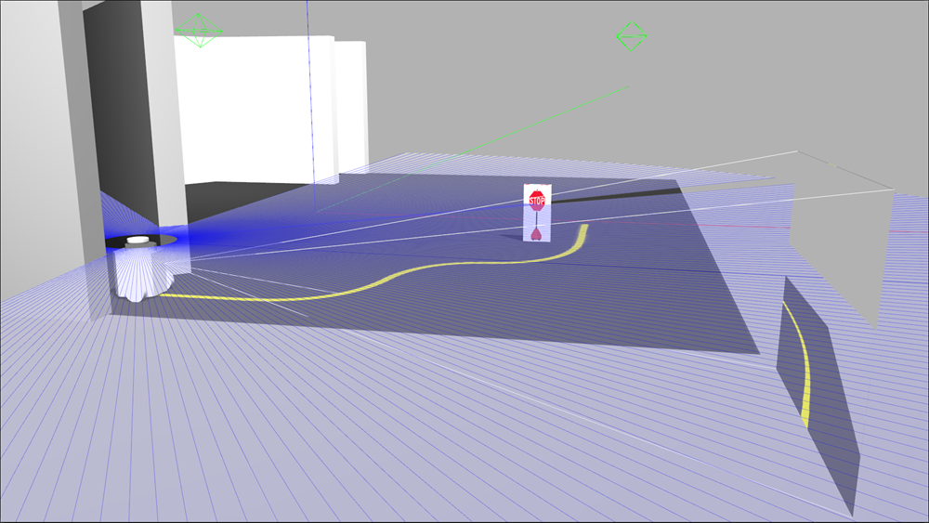
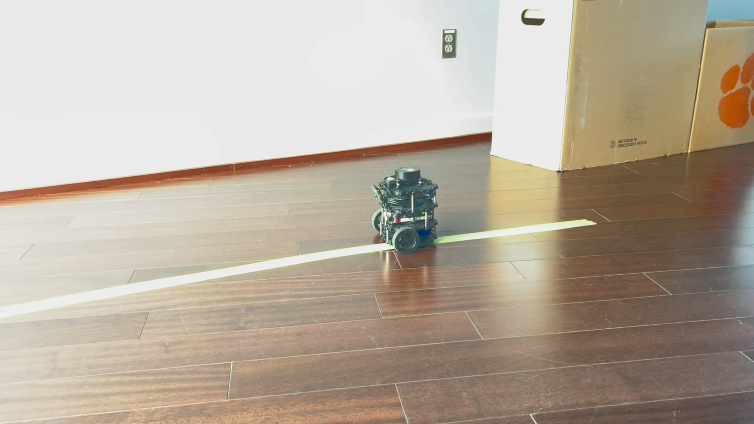
Task 3
Line Following

Slide 3
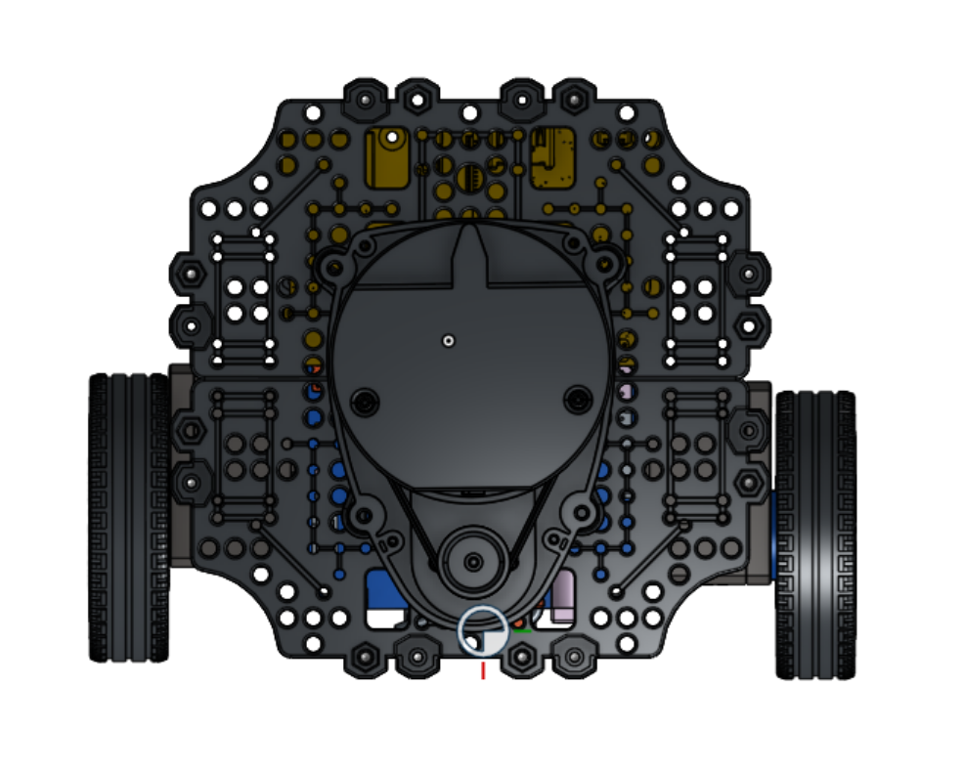
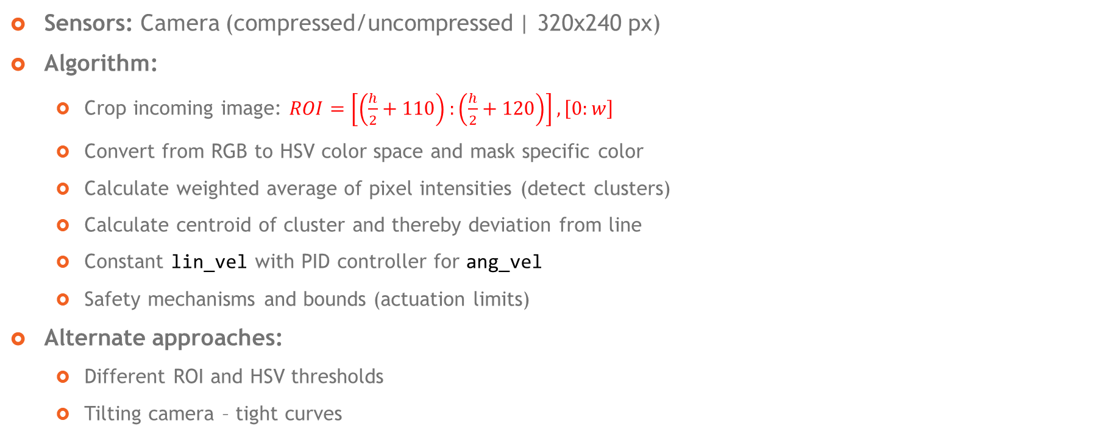
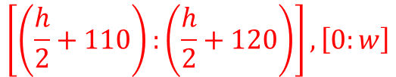
Approach
$$\left[\left(\frac{h}{2}+110\right):\left(\frac{h}{2}+120\right)\right], \left[0:w\right]$$
Sensors: Camera (compressed/uncompressed | 320x240 px)
Algorithm:
Crop incoming image: $ROI=\left[\left(\frac{h}{2}+110\right):\left(\frac{h}{2}+120\right)\right], \left[0:w\right]$
Convert from RGB to HSV color space and mask specific color
Calculate weighted average of pixel intensities (detect clusters)
Calculate centroid of cluster and thereby deviation from line
Constant lin_vel with PID controller for ang_vel
Safety mechanisms and bounds (actuation limits)
Alternate approaches:
Different ROI and HSV thresholds
Tilting camera – tight curves

Slide 4
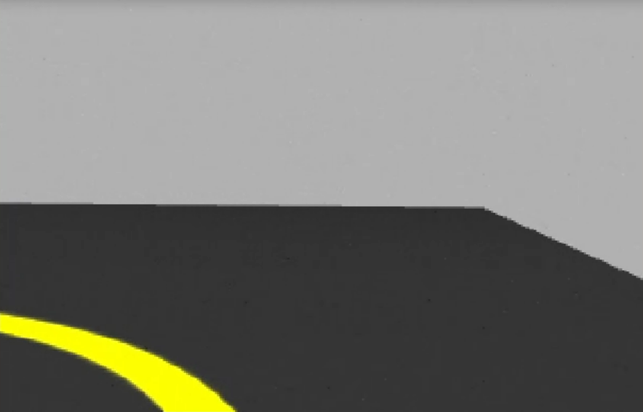
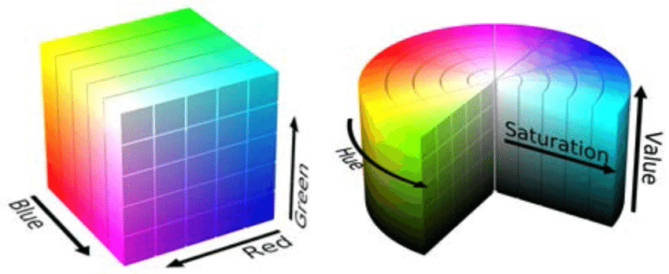

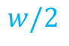


Approach
$$w$$
$$w/2$$
Sensors: Camera (compressed/uncompressed | 320x240 px)
Algorithm:
Crop incoming image: $ROI=\left[\left(\frac{h}{2}+110\right):\left(\frac{h}{2}+120\right)\right], \left[0:w\right]$
Convert from RGB to HSV color space and mask specific color
Calculate weighted average of pixel intensities (detect clusters)
Calculate centroid of cluster and thereby deviation from line
Constant lin_vel with PID controller for ang_vel
Safety mechanisms and bounds (actuation limits)
Alternate approaches:
Different ROI and HSV thresholds
Tilting camera – tight curves
$$h$$
$$CTE$$

Slide 5
Approach
START
Initialize
Subscribe Image
Sensors: Camera (compressed/uncompressed | 320x240 px)
Algorithm:
Crop incoming image: $ROI=\left[\left(\frac{h}{2}+110\right):\left(\frac{h}{2}+120\right)\right], \left[0:w\right]$
Convert from RGB to HSV color space and mask specific color
Calculate weighted average of pixel intensities (detect clusters)
Calculate centroid of cluster and thereby deviation from line
Constant lin_vel with PID controller for ang_vel
Safety mechanisms and bounds (actuation limits)
Alternate approaches:
Different ROI and HSV thresholds
Tilting camera – tight curves
Crop Image
Convert from RGB to HSV
Compute moments
Apply HSV Thresholds
Yes
Cluster detected?
No
c_x, c_y = m10/m00, m01/m00
c_x, c_y = w/2, h/2
CTE = (w/2 - c_x + 10)/175
LIN_VEL = 0.05 m/s
ANG_VEL = PID_LAT(CTE)
Bound LIN_VEL and ANG_VEL
Publish CMD_VEL =
{LIN_VEL, ANG_VEL}
END

Slide 6
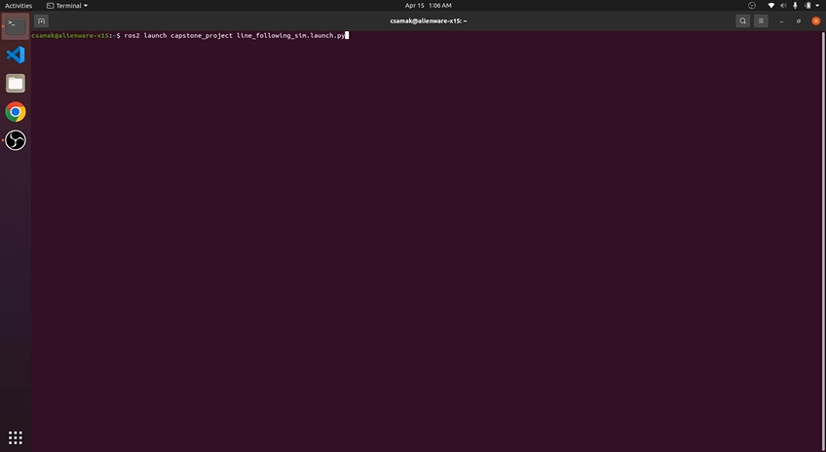
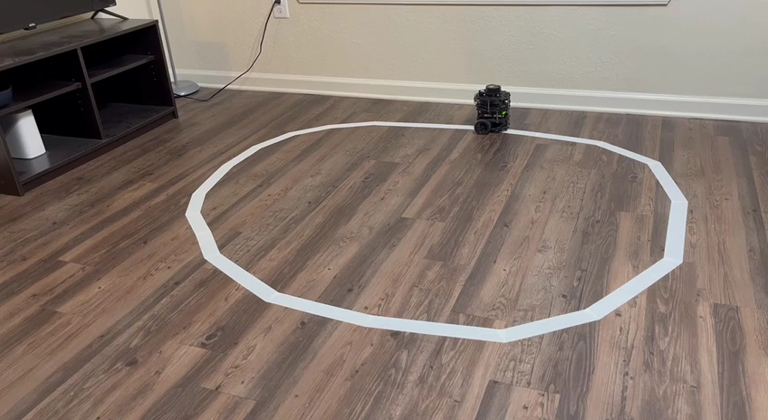
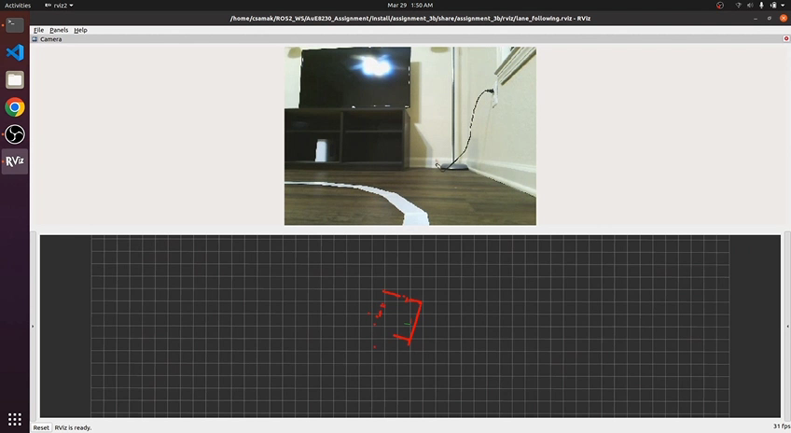
Results
Simulation
TurtleBot3
Remote PC

Slide 7
Thank you!
…open to questions and suggestions

